Slide 1
Small-Signal Analysis
BJT

Slide 2
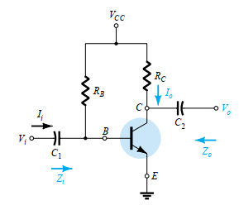
The transistor models are used to perform a small signal ac analysis of a number of standard transistor network configurations
COMMON-EMITTER FIXED-BIAS CONFIGURATION
Note
Input signal Vi is applied to the base of the transistor while the output Vo is off the collector.
Input current Ii is not the base current but the source current, while the output current Io is the collector current.

Slide 3
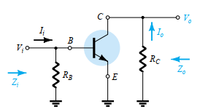
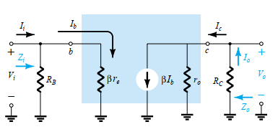
The small-signal ac analysis begins by:
removing the dc effects of VCC
replacing the dc blocking capacitors C1 and C2 by short-circuit equivalents, resulting in the network of figure below
=

Slide 4


The next step is to determine β, re, and ro.
The magnitude of β is typically obtained from a specification sheet or by direct measurement using a curve tracer or transistor testing instrument.
The value of re must be determined from a dc analysis of the system, and
the magnitude of ro is typically obtained from the specification sheet or characteristics.
Hence;
Input impedance Zi is given by;
For the majority of situations RB is greater than βre by more than a factor of 10 thus;

Slide 5
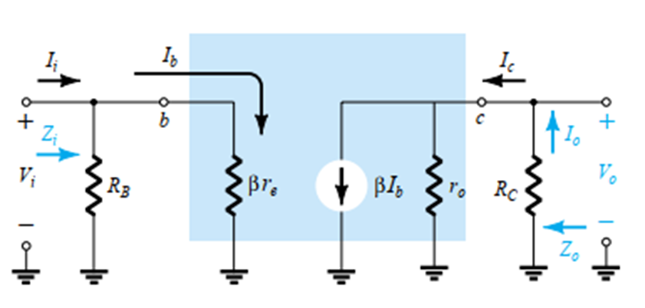
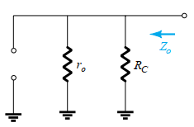
Output impedance Zo;
The output impedance of any system is defined as the impedance Zo
determined when Vi = 0. For Figure (a), when Vi = 0, Ii = Ib = 0, resulting in an open-circuit equivalence for the current source. The result is the configuration of figure (b)
(a) (b)

Slide 6

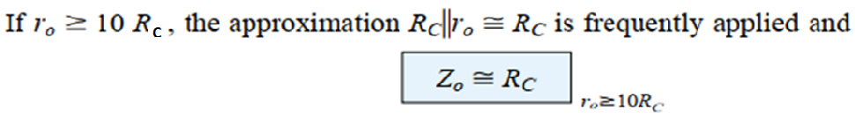

Hence;
Voltage gain Av
Since the resistors ro and RC are in parallel,
Thus,

Slide 7
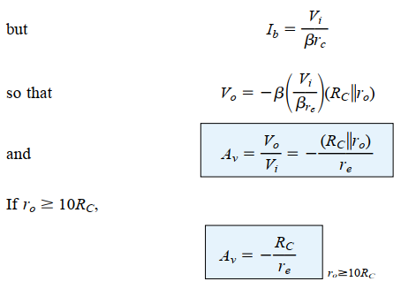

Slide 8
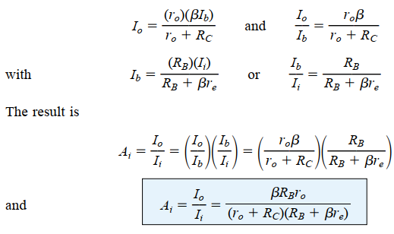
The current gain Ai:
Applying the current-divider rule to the input and output circuits,

Slide 9
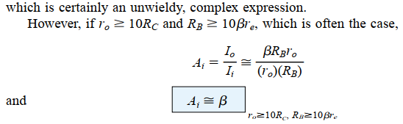

Utilizing Ao and Zi. That is,
Phase Relationship:
The negative sign in the resulting equation for Av reveals that a 180° phase shift occurs between the input and output signals, as shown in the figure below.

Slide 10
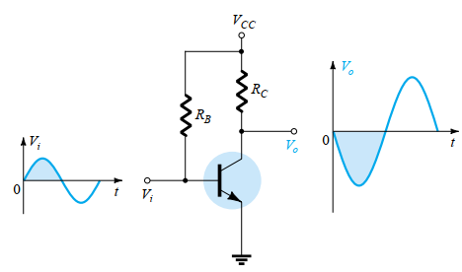
Demonstrating the 180° phase shift between input and output waveforms.

Slide 11
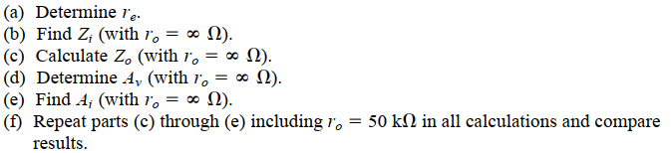
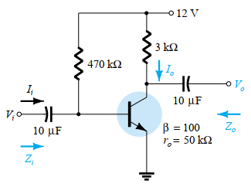
For the network of the figure shown

Slide 12
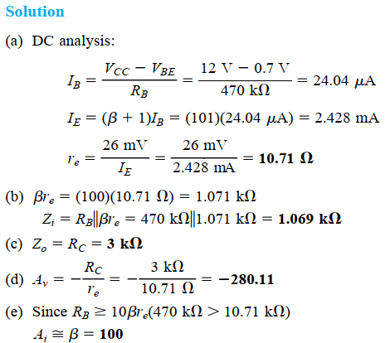

Slide 13
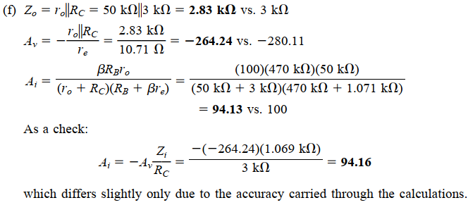

Slide 14
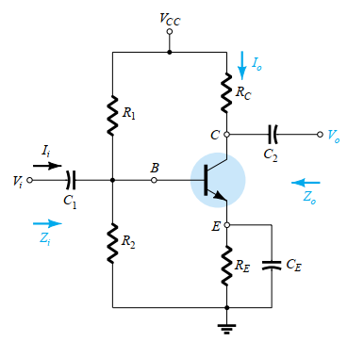
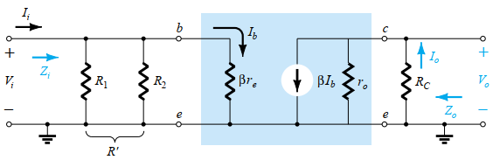
VOLTAGE-DIVIDER BIAS
The name of the configuration is a result of the voltage-divider bias at the
input side to determine the dc level of VB.
=
T The re equivalent circuit

Slide 15


When VCC is set to zero, one end of R1 and RC is set at ground potential as shown
Note that R1 and R2 remain part of the input circuit while RC is part of the output circuit.
The parallel combination of R1 and R2 is defined by;
Zi:
From equivalent circuit ;

Slide 16
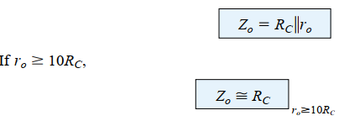
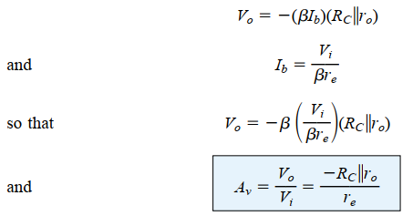
Zo:
From the Fig. with Vi set to 0 V resulting in Ib = 0μA and βIb = 0mA
Av: Since RC and ro are in parallel,

Slide 17
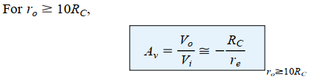
-

Slide 18
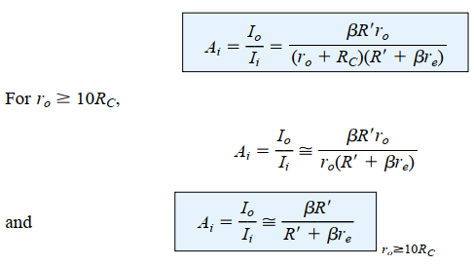
Ai: The current gain is given by;

Slide 19
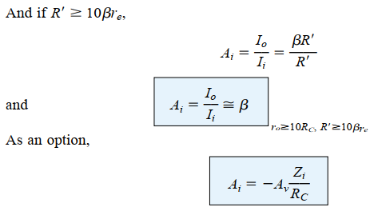
Phase relationship:
The negative sign reveals a 180° phase shift between Vo and Vi

Slide 20
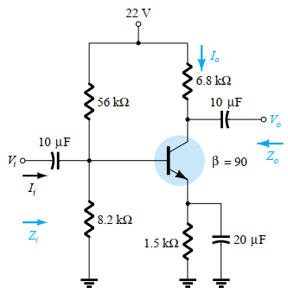
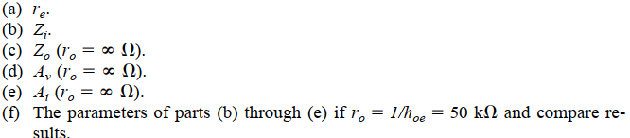
Example 2
For the network given, determine:

Slide 21
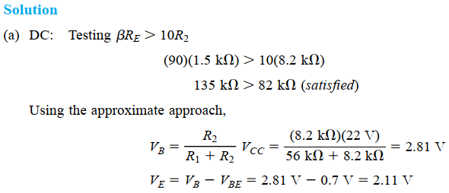

Slide 22
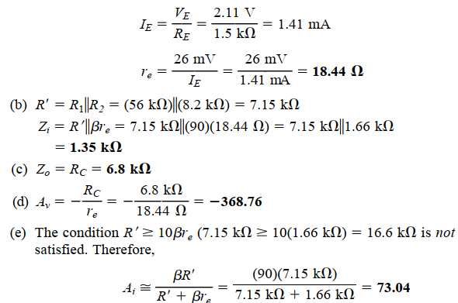

Slide 23
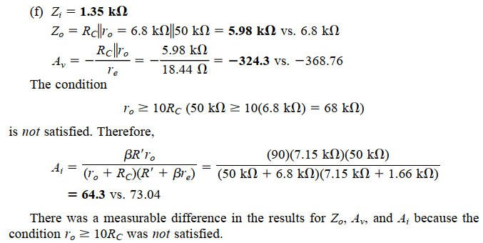

Slide 24
Please!
WORK ON CE EMITTER-BIAS CONFIGURATION
&
COMMON-BASE CONFIGURATION

Slide 25
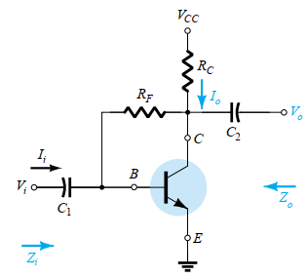
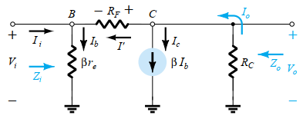
COLLECTOR FEEDBACK CONFIGURATION
The collector feedback network of Fig. below employs a feedback path from collector to base to increase the stability of the system
=

Slide 26
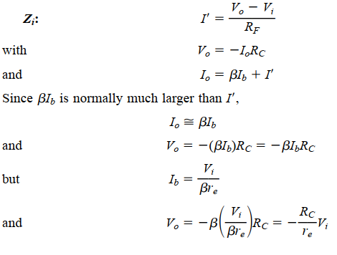

Slide 27
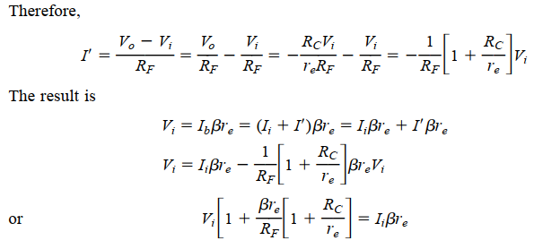
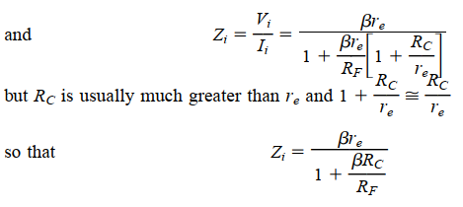

Slide 28
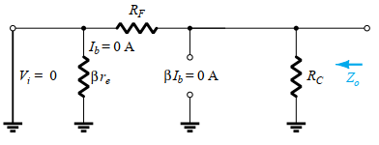
Zo;
If we set Vi to zero as required to define Zo, the network will appear as shown in Fig. below. The effect of re is removed and RF appears in parallel with RC
Thus;
Zo = RC//RF

Slide 29
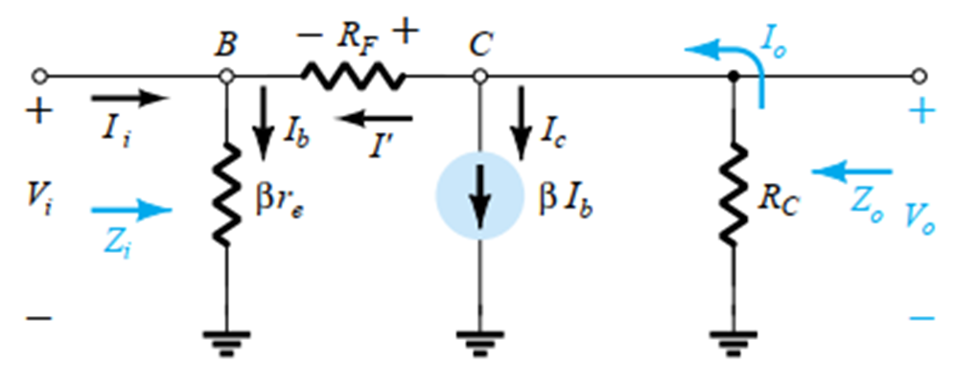
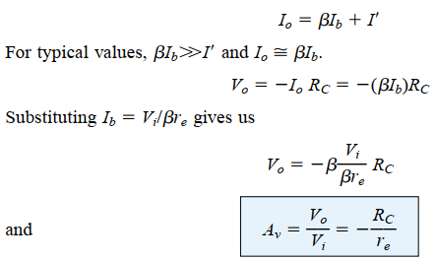
Av: At node C of Fig
Phase relationship: The negative sign reveals a 180° phase shift
between Vo and V

Slide 30
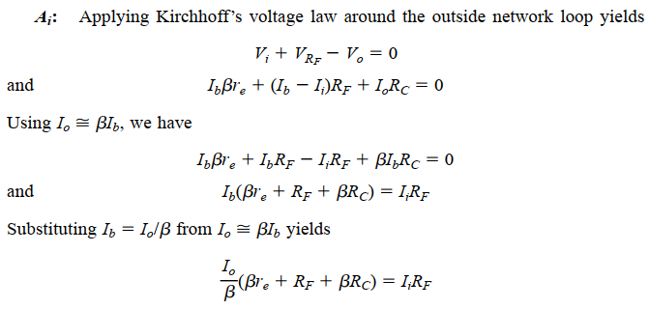

Slide 31
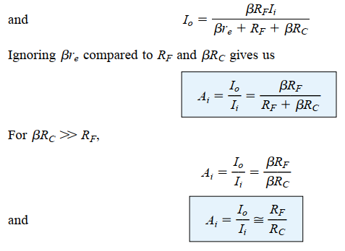

Slide 32
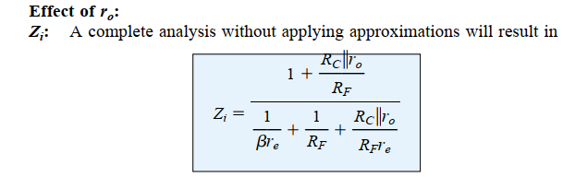
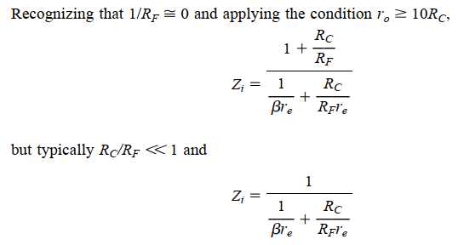

Slide 33
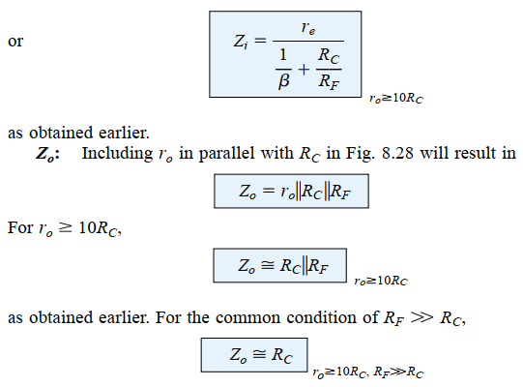

Slide 34
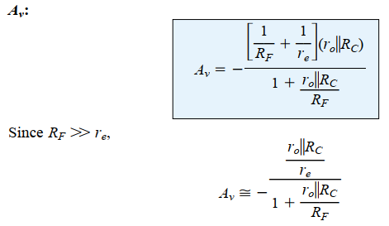
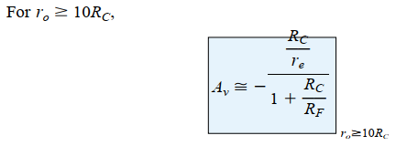

Slide 35
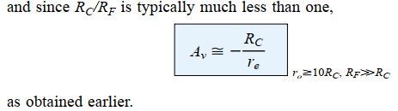
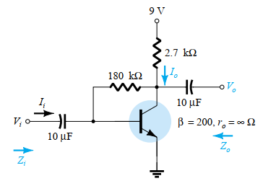

Example 3 For the network given, determine:

Slide 36
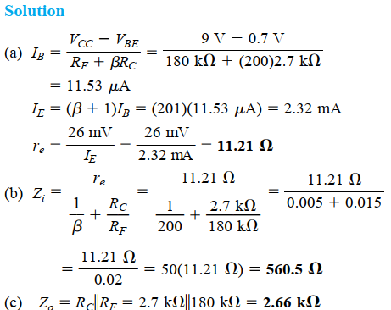

Slide 37
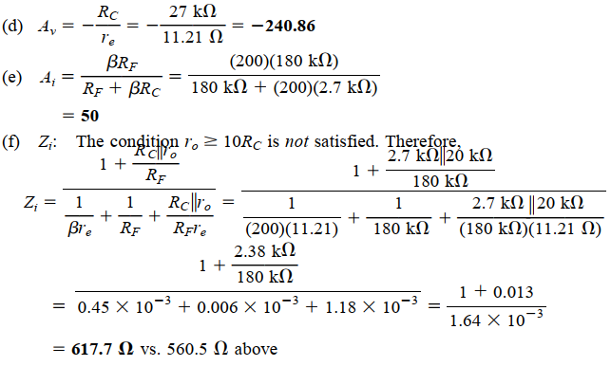


Slide 38
